Slide 1
Chapter 6
Supply chain management

Slide 2

Learning outcomes
Identify the main elements of supply chain management and their relationship to the value chain and value networks
Assess the potential of information systems to support supply chain management and the value chain

Slide 3

Management issues
Which technologies should we deploy for supply chain management and how should they be prioritised?
Which elements of the supply chain should be managed within and beyond the organisation and how can technology be used to facilitate this?
What are the practical issues with online supply chain management?

Slide 4
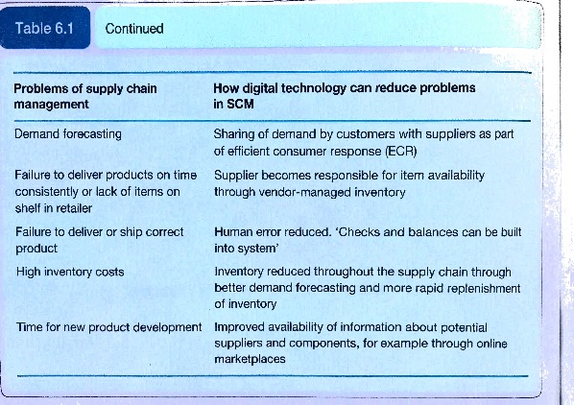
SCM – some definitions
Supply chain management is essentially the optimization of material flows and associated information flows involved with an organisation’s operations.
Problems with SCM

Slide 5
SCM – some definitions
Supply chain management (SCM) The coordination of all supply activities of an organisation from its suppliers and partners to its customers.
Upstream supply chain Transactions between an organisation and its suppliers and intermediaries, equivalent to buy-side e-commerce.
Downstream supply chain Transactions between an organisation and its customers and intermediaries, equivalent to sell-side e-commerce.
Supply Chain Network is the links between an organisation and its partners.
Efficient Consumer Response(ECR) Creating and satisfying customer demand by optimising product assortment strategies, promotions, and new product introductions

Slide 6
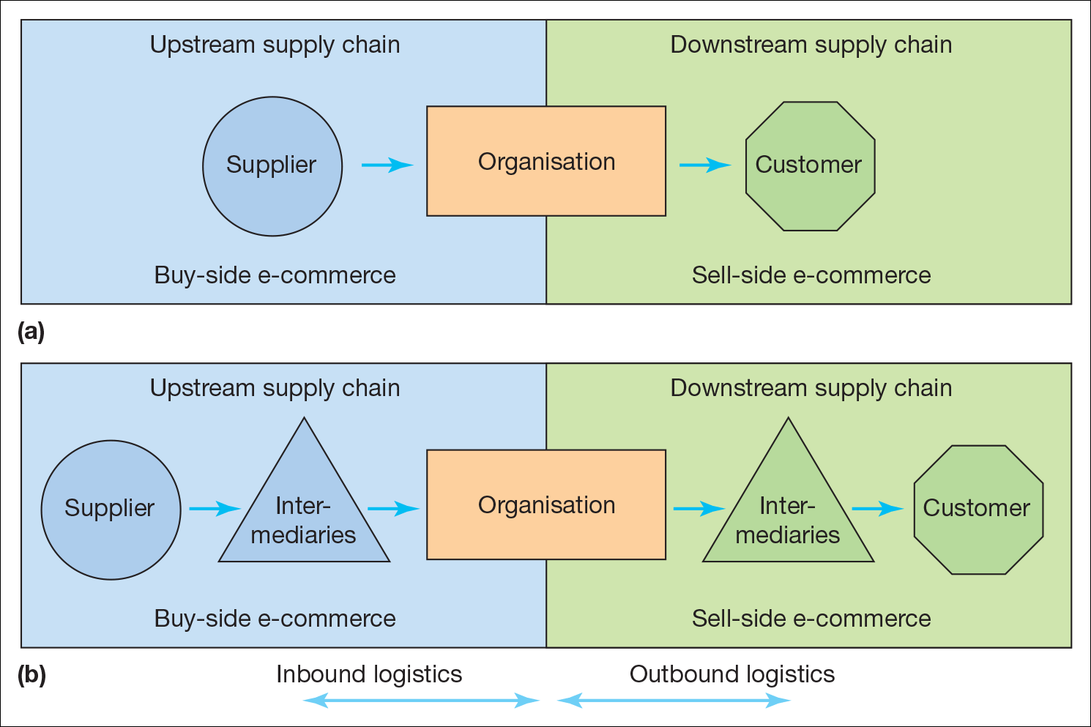
Members of the supply chain: (a) Simplified view, (b) Including intermediaries

Slide 7
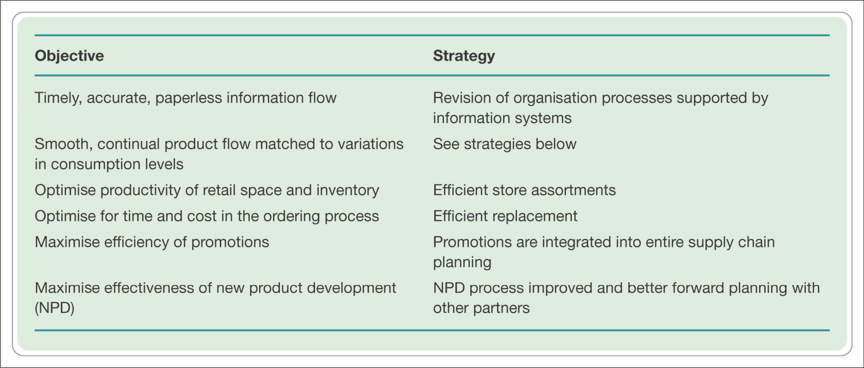
Objectives and strategies for effective consumer response (ECR)

Slide 8
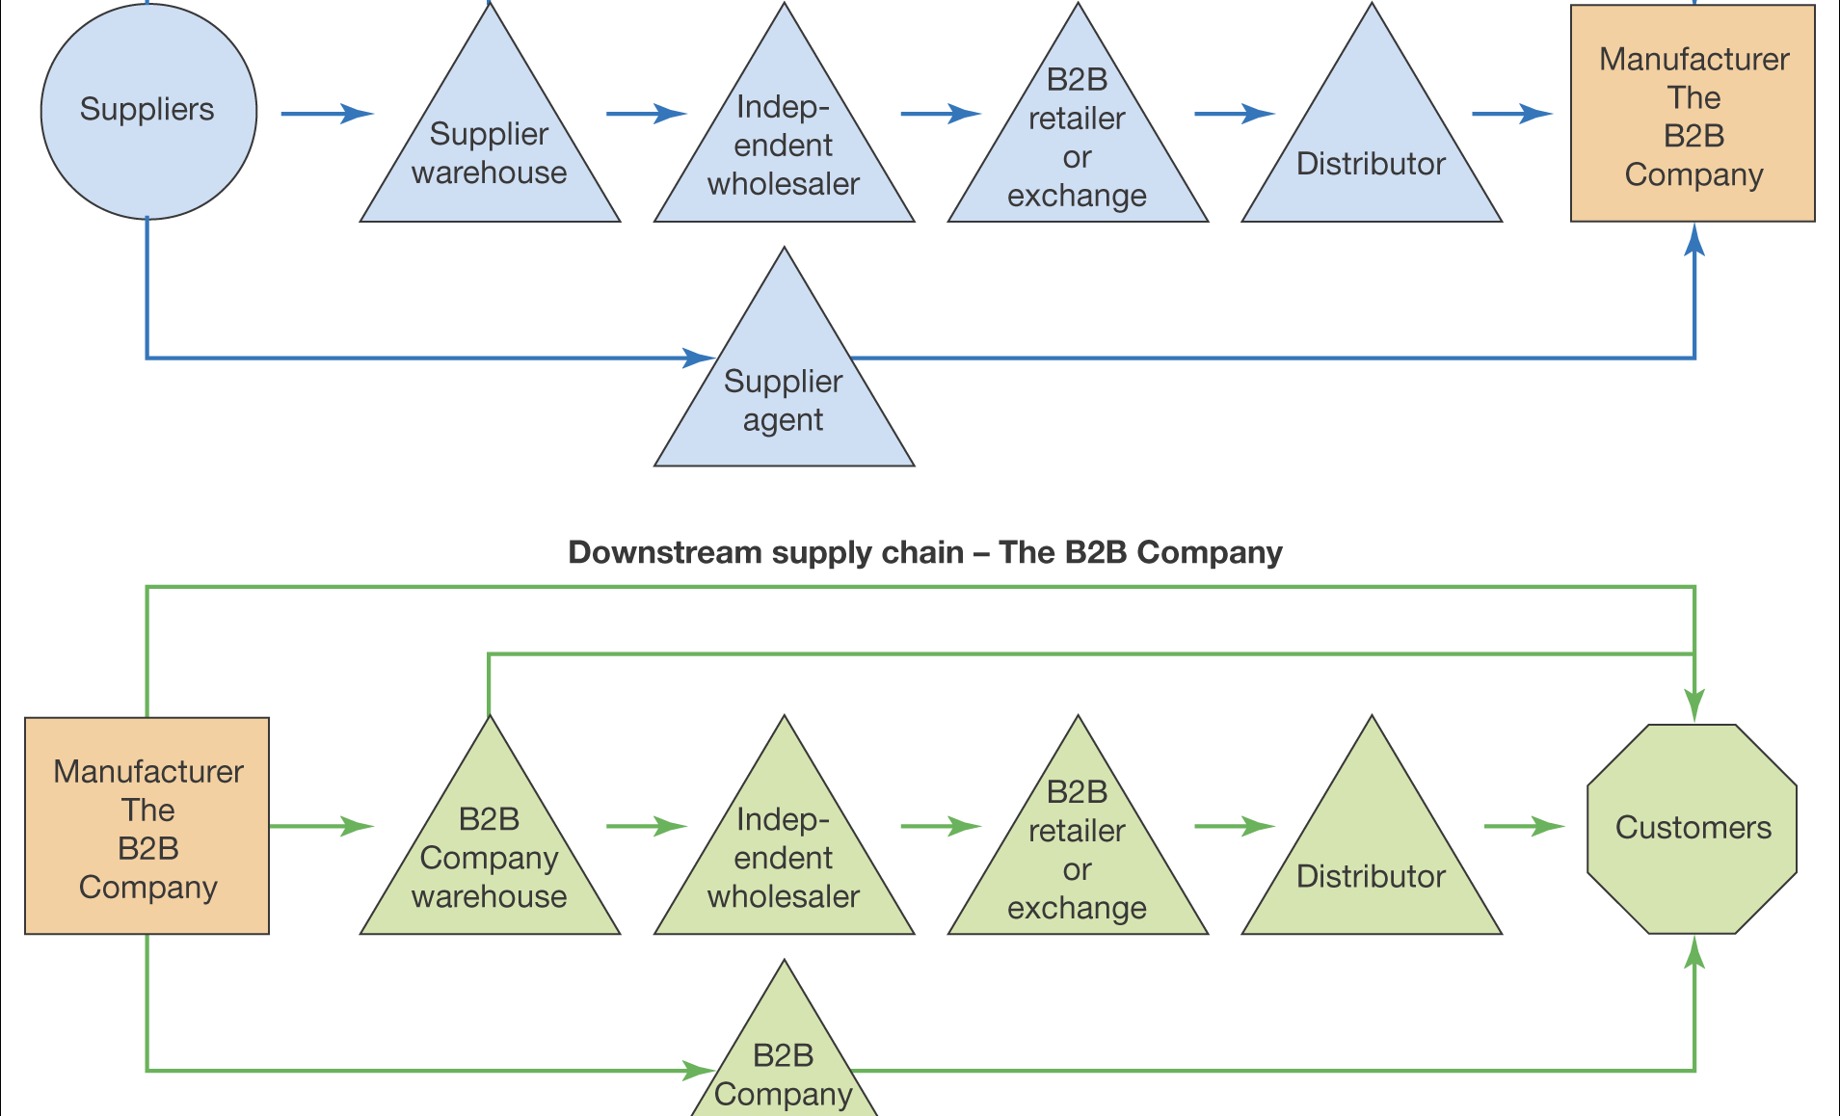
A typical supply chain for a B2B company

Slide 9
Logistics
Logistics is a concept closely related to supply chain management. According to Institute of Logistics and Transportation(www.ilot.orga):
Logistics is the time-related positioning of resource, or the strategic management of the total supply chain. The supply chain is a sequence of events intended to satisfy a customer. It can include procurement, manufacture, distribution, and waste disposal, together with associated transport, storage and information technology.
Inbound logistics – the management of material resources entering an organisation from its suppliers and other partners.
Outbound logistics – the management of resources supplied from an organisation to its customers and intermediaries

Slide 10
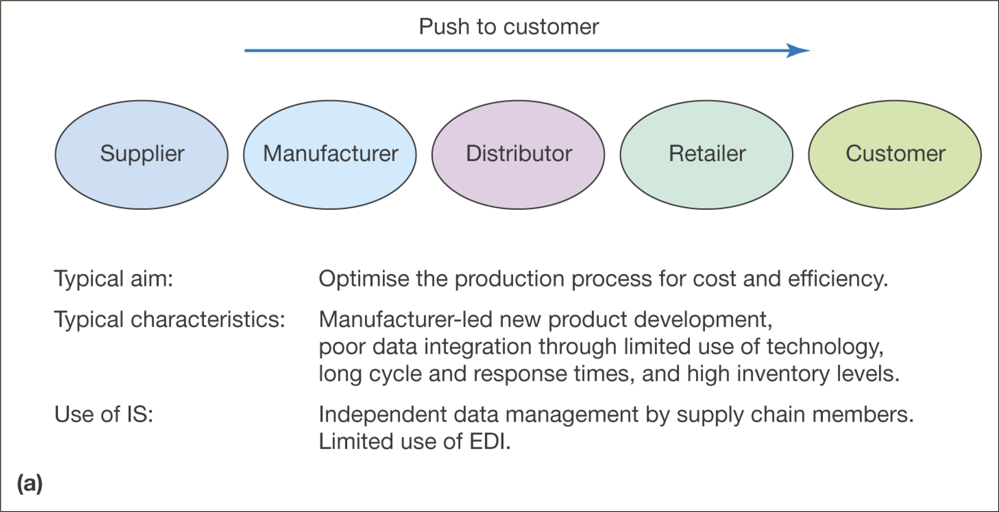
Push and pull approaches to supply chain management
Push Supply Chain emphasises distribution of a product to passive customers

Slide 11
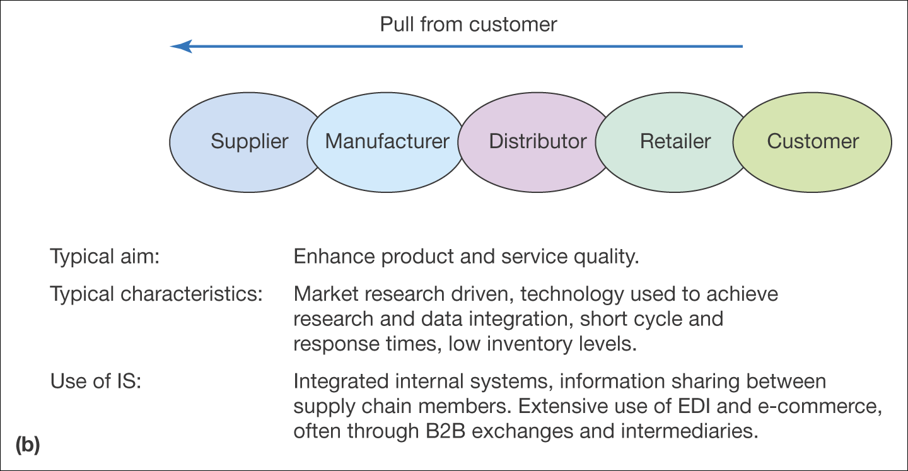
Push and pull approaches to supply chain management (Continued)
Pull Supply Chain emphasises on using the supply chain to deliver value to customers who are actively involved in product and service specification

Slide 12
Value Chain
Value Chain is a concept/model that considers how supply chain activities can add value to products and services delivered to the customer.
Internal value chain within the boundaries of an organisation and an external value chain where activities are performed by partners.
Benefits for the customer are created by reducing cost and adding value:
Within each element of the value chain such as procurement, manufacture, sales and distribution;
At the interface between elements of the value chain such as between sales and distribution.
Primary activities – that contribute directly to getting goods and services to the customer and
Support (Secondary) activities which provide the inputs and infrastructure that allow the primary activities to take place.

Slide 13
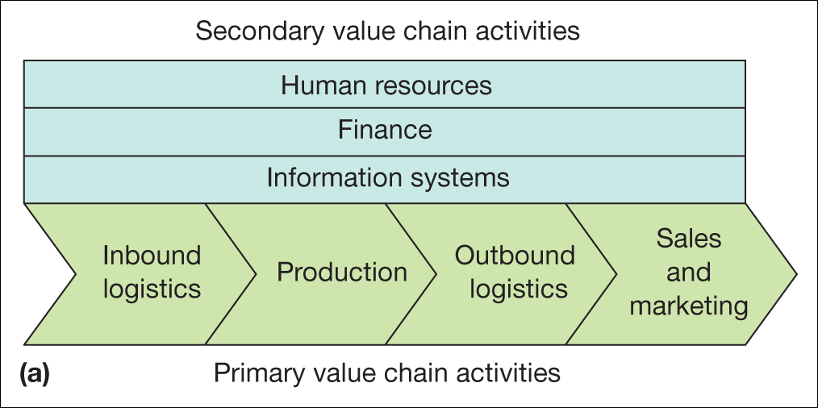
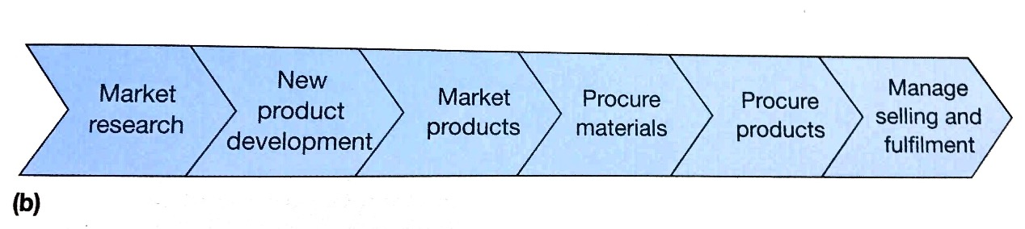
Two alternative models of the value chain:
(a) Traditional value chain model
(b) Revised value chain model Source: Adapted from Deise et al. (2000) Figure 6.4(b).

Slide 14
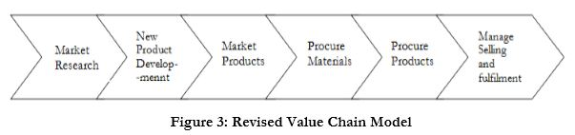
Value Chain – disadvantages and restructuring
Traditional models of the value chain have been re-evalued with the advent of global electronic communications.
Weaknesses in traditional value chain:
It is most applicable to manufacturing of physical products as opposed to providing services
It is a one-way chain involved with pushing products to the customer; it does not highlight the importance of understanding customer needs.
The internal value chain does not emphasise the importance of value networks.
A revised form of value chain has been suggested by Deise et al(2000) as shown below.

Slide 15
Value Stream
Value Stream is a concept that is closely related to the value chain. It is the combination of actions required to deliver value to the customer as products and services.
Value Stream is defined as the set of all the specific actions required to bring a specific product through the three critical management tasks of any business:
The problem solving task[the process of new product development and production launch]
The information management task[the process of order taking, scheduling to delivery]
The physical transformation task[the process of transforming raw materials to finished product delivered to customers]
Tasks 2 and 3 are traditional value chain activities, but not task 1
The main aim is adding value by cutting out waste in each of these three management tasks.

Slide 16
Value Chain Analysis
Value Chain Analysis is an analytical framework for decomposing an organisation into its individual activities and determining value added at each stage.
Porter and Miller(1985) propose the following five-step process:
Step 1: Assess the information intensity of the value chain
Step 2: Determine the role of IS in industry structure.
Step 3:Identify and rank the ways in which IS might create competitive advantage.
Step 4: Investigate how IS might spawn new businesses
Step 5: Develop a plan for taking advantage of IS, which is business driven rather than technology driven.

Slide 17
External value chain or Value networks
The links between an organisation and its strategic and non-strategic partners that form its external value chain.
As companies outsource more and more activities, management of the links between the company and its partners becomes more important.
Electronic communications have enabled the transfer of information necessary to create, manage and monitor outsourcing partnerships.
These links are also mediated through intermediaries known as ‘Value chain integrators’ or directly between partners.

Slide 18
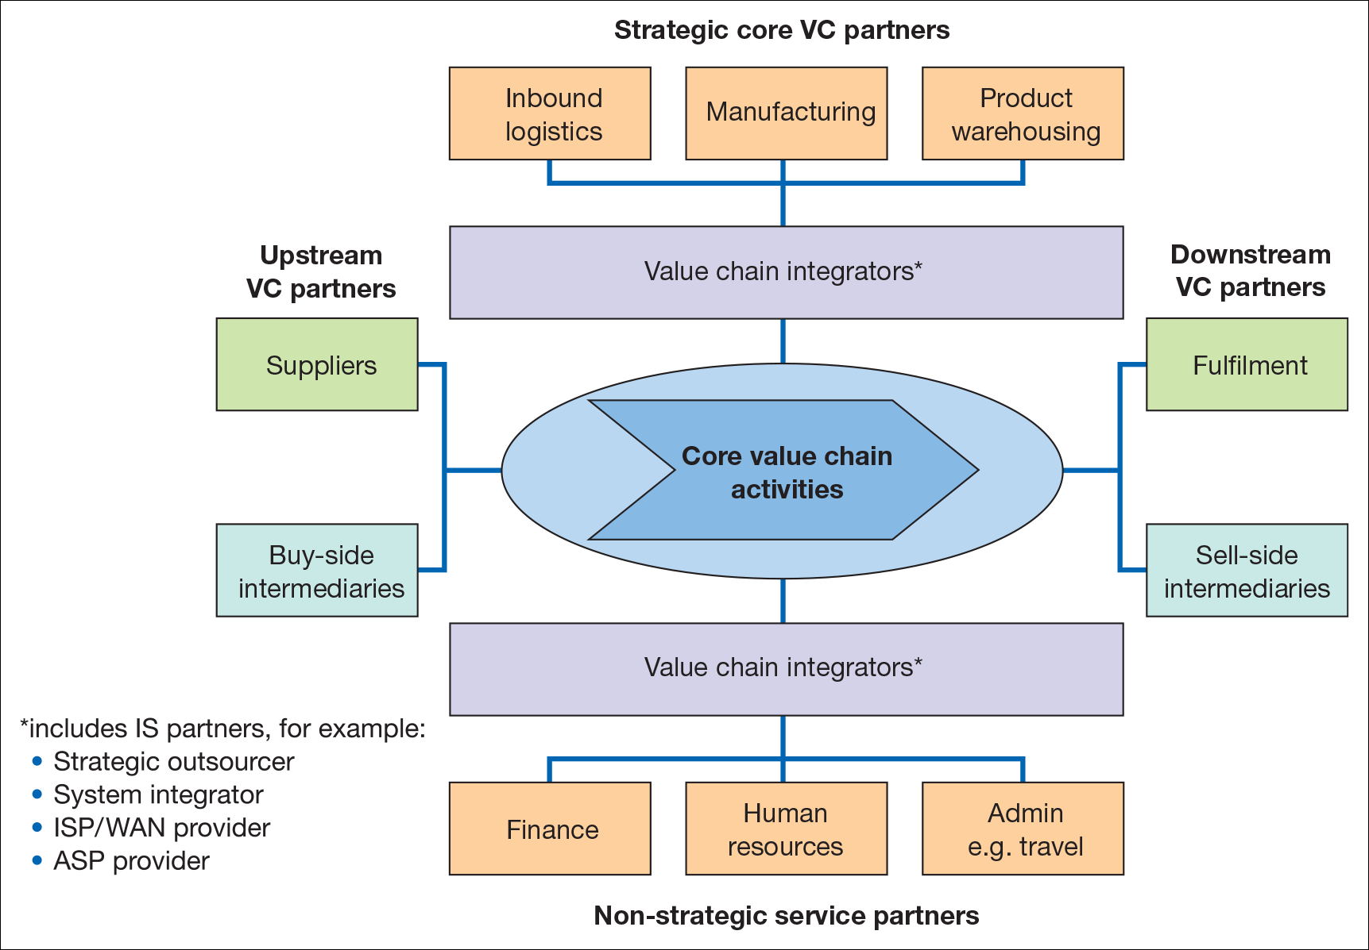
Members of the value network of an organisation Source: Adapted from Deise et al. (2000).

Slide 19
Partners/members of value networks
Supply-side partners (upstream supply chain) such as suppliers, business-to-business exchanges, wholesalers and distributors.
Partners that fulfil primary or core value chain activities. In some companies the management of inbound logistics may be outsourced, in others different aspects of the manufacturing process. In virtual organisation, all core activities may be outsourced.
Sell-side partners(downstream supply chain) such as business-to-business exchanges, wholesalers, distributors and customers
Value chain integrators or partners who supply services that mediate the internal and external value chain. These companies typically provide the electronic infrastructure for a company

Slide 20
Virtual Organisation
An organisation which uses information and communications technology to allow it to operate without clearly defined physical boundaries between different functions.
Different characteristics of virtual organisations:
Lack of physical structure
Reliance on knowledge
Use of communications technologies
Mobile network
Boundaryless and inclusive
Flexible and responsive
Virtualisation is a process of a company developing more of the characteristics of the virtual organisation.

Slide 21
Options for restructuring the supply chain
The choices have mainly existed for many years for traditional supply chain. However, Internet technology provides a more efficient enabler and lower-cost communications.
Vertical Integration, the extent to which the supply chain activities are undertaken and controlled within the organisation
Virtual Integration, the majority of supply chain activities are undertaken and controlled outside the organisation by third parties.
The intermediate situation is referred to as Vertical Disintegration or supply chain disaggregation

Slide 22
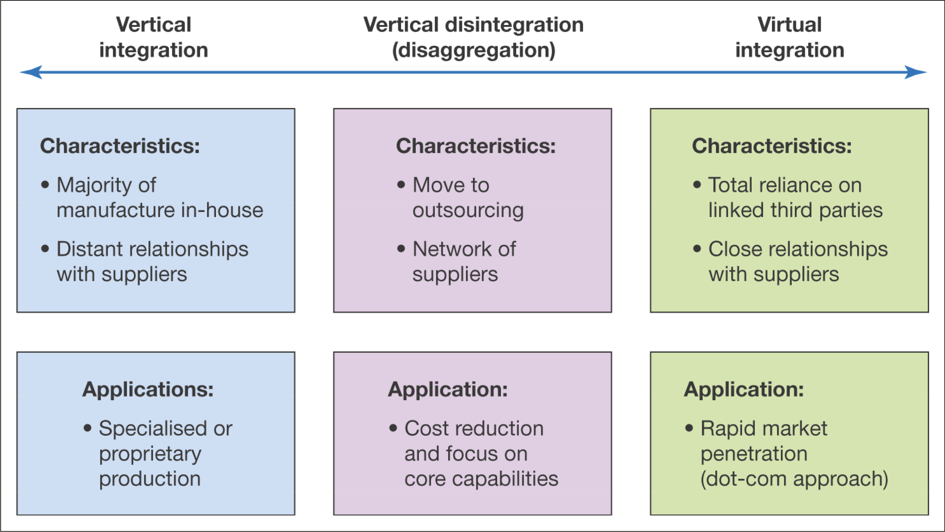
The characteristics of vertical integration, vertical disintegration and virtual integration

Slide 23
Using DB to restructure the SC
Using digital communications to improve supply chain efficiently is dependent of effective exchange and sharing of information.
The challenges of achieving standard data formats and data exchange have given rise to the study of the information supply chain (ISC).
ISC is an information-centric view of the supply chain which addresses the organisational and technological challenges of achieving technology enabled supply chain management efficiency and effectiveness.
Information Asymmetry(bullwhip effect) is an imperfect information sharing between members of a supply chain which increases uncertainty about demand and pricing

Slide 24
Technology options & standards for SCM
EDI, Electronic Data Exchange, is an established and relatively simple method of exchanging orders, delivery notes and invoices.
XML- or XML-EDI, based data transfer enables more sophisticated one-to-many data transfers.
Middleware or software used to integrate or translate requests from external systems in real time so they are understood by internal systems.
Manual email orders or online purchase through a traditional web-based e-commerce store for B2B.
ERP systems enable the above data transfer.
SaaS is recent option available through cloud.

Slide 25
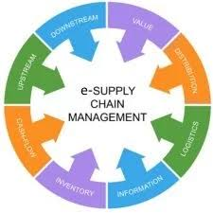
e-supply chain management
Typical benefits include:
Increased efficiency of individual processes.
Reduced complexity of the supply chain.
Improved data integration between elements of the supply chain.
Reduced cost through outsourcing.
Innovation.
Despite the benefits, adoption rate is low, particularly in amongst small companies that use manual systems.

Slide 26
e-supply chain management – RFID, IOT, M2M, Infrastructure
RFID tags
Radio Frequency Identification tags are micro-chip based electronic tags used for monitoring anything they are attached to, whether inanimate products or animate(people)
IOT
Internet of Things, objects are uniquely identified and tagged through technologies such as RFID and made accessible through internet-like addresses.
M2M
Machine-to-Machine applications, same as IOT
IS Infrastructure/Supply Chain Visibility
Access to up-to-date, accurate, relevant information about supply chain processes to different stakeholders

Slide 27
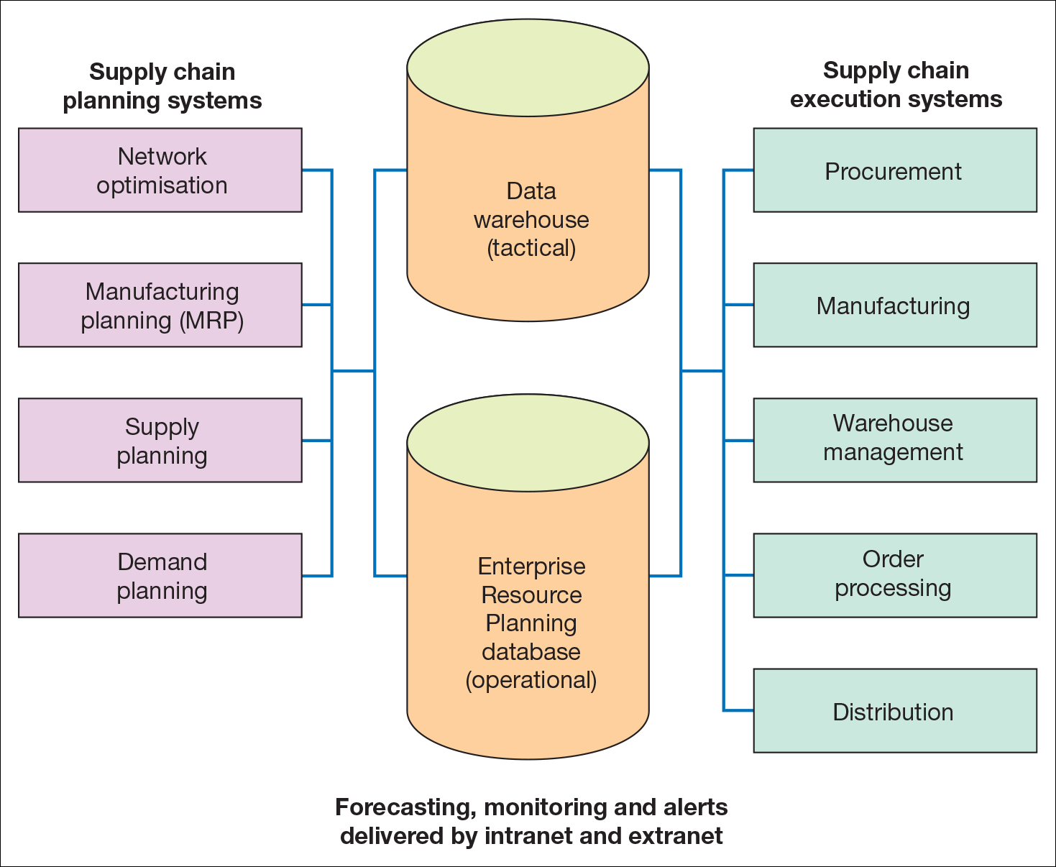
A typical IS infrastructure for supply chain management

Slide 28
SCM Implementation
Managing supply chain is very challenging as found out in a specific survey,
one responded said: ‘An absolute nightmare’ and there are many more stories.
One of the difficulties is Data standardisation and exchange
GDSN(Global Data Synchronisation Network) is an approach to create standards for sharing information about retail products
SCM strategy process such as SOSTAC has been adopted in implementing SCM.
Situation Analysis
Objective Setting
Strategy
Tactics
Actions
Control

Slide 29
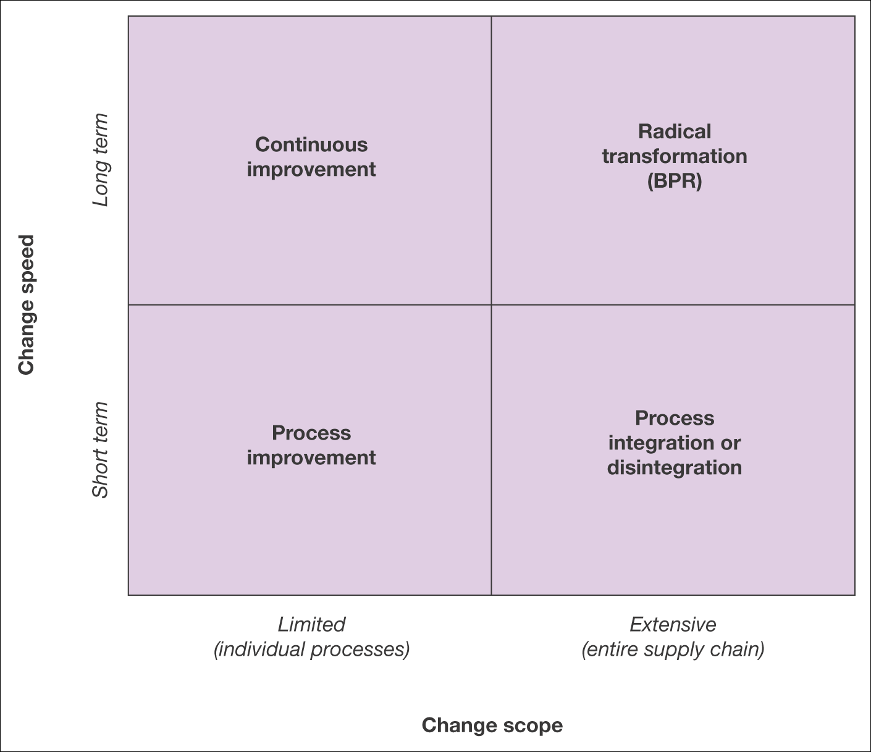
Alternative strategies for modification of the digital business supply chain

